Slide 1
LRSHRM Virtual Meeting April 2, 2020 12 noon

Slide 2
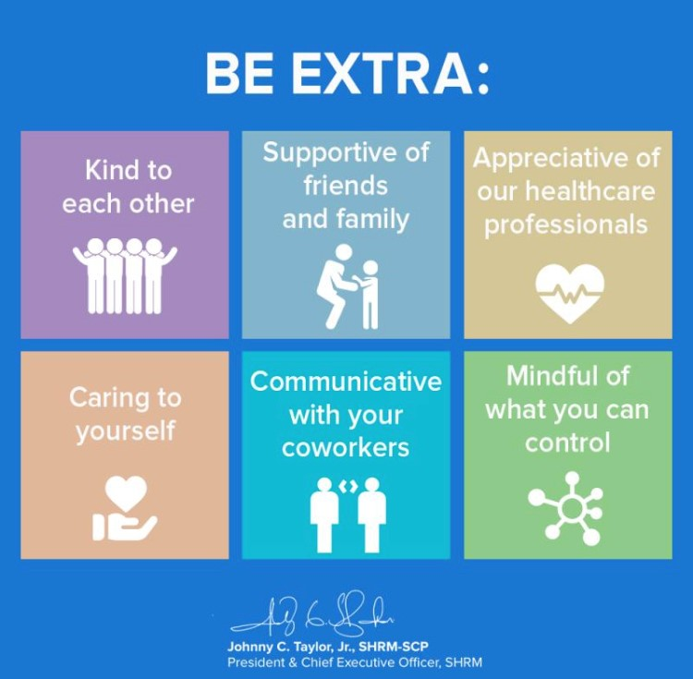
DO what HR does
take care of our people
Take care of yourself, your family, your employees and your company

Slide 3
Mental Health

Slide 4
Be aware of the stigma around mental health, don’t buy into it
Keep work and life separate
Reassure kids they are safe
Create a self-care plan, sleep, offline before bed, exercise, hobbies, for YOU and your KIDS
Know your triggers and don’t be afraid to ask for help, reflect on causes and signs of stress, talk with someone
Be kind to yourself, it’s okay ‘not to be okay’ during tough times.
Treat yourself and others with compassion

